Slide 1
Machine Learning-based Air Pollution Prediction
_{Submitted by:}
_{M. Akhil(AP21110020013)}
_{N. Nikhil(AP21110020068)}

Slide 2
CONTENTS
01 INTRODUCTION 02 PROBLEM STATEMENT 03 METHODOLOGY 04 FLOWCHART
05 OUTPUTS 06 CONCLUSION

Slide 3
01
INTRODUCTION
Air quality is a major concern in many nations throughout the world due to the negative
impact of air pollution on human health and the environment.
Machine learning techniques can be used to predict air pollution levels
Air quality models can also be used to predict future pollutant concentrations from multiple
sources after the implementation of a new regulatory program, in order to estimate the
effectiveness of the program in reducing harmful exposures to humans and the environment.
Machine learning techniques can be used to predict air pollution levels
Comparing the performances of different machine learning methods, random forest
regression had the highest accuracy and the lowest RMSE in predicting air pollution levels

Slide 4
02 PROBLEM STATEMENT
The goal of machine learning-based air pollution prediction is to develop a model that can accurately predict future air pollution levels based on historical data. This can be a challenging task, as air pollution levels are affected by a variety of factors, including meteorology, emissions from vehicles and industry, and topography.

Slide 5
Methodology
Linear Regression :- Linear regression is used to predict the continuous dependent variable using a given set of independent variables.
LASSO Regression :- LASSO stands for Least Absolute Shrinkage and Selection Operator. It is used
over regression methods for a more accurate prediction.
Random Forest Regression :- It is a supervised learning algorithm and bagging technique that uses an
ensemble learning method for regression in machine learning. It is used to predict future values.
K-nearest neighbour regression :- It is a popular machine learning technique used for classification and regression tasks.

Slide 6
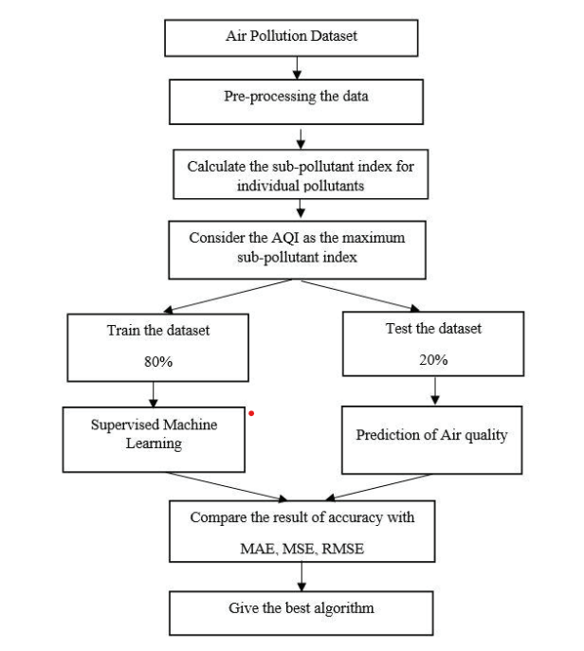

Slide 7
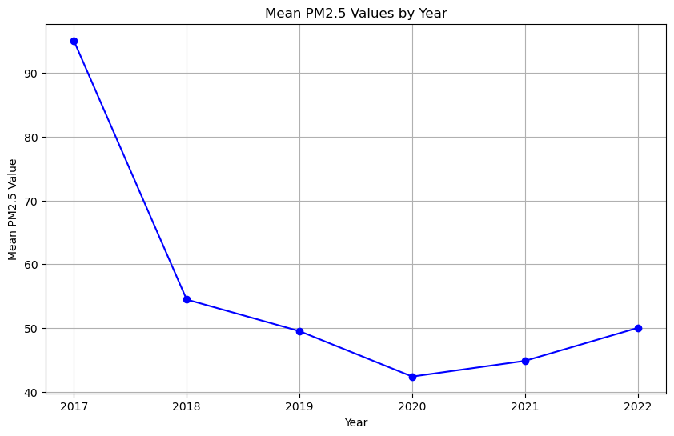
OUTPUT

Slide 8
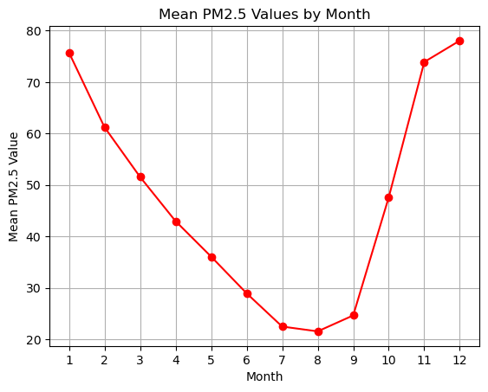

Slide 9
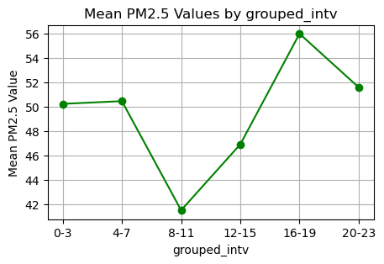

Slide 10
CONCLUSION
Machine learning-based air pollution prediction is a promising area of research with the potential to have a significant impact on public health and environmental management. By developing accurate and reliable models, we can warn the public about high pollution levels, develop effective air pollution control strategies, and improve air quality overall.

Slide 11
THANK YOU

